Slide 1

CS410 Project -- ExpertSearch System
Bruno seo
Joseph Angulo
Xiaohan Liu

Slide 2
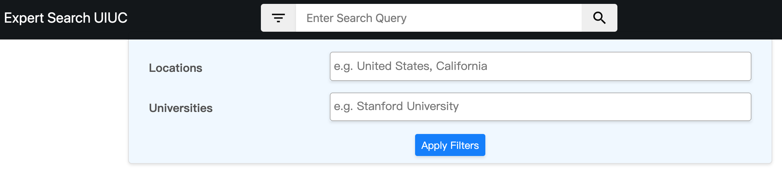
Introduction
The ExpertSearch system is a webpage-based search engine that provides search function for faculty information.

Slide 3
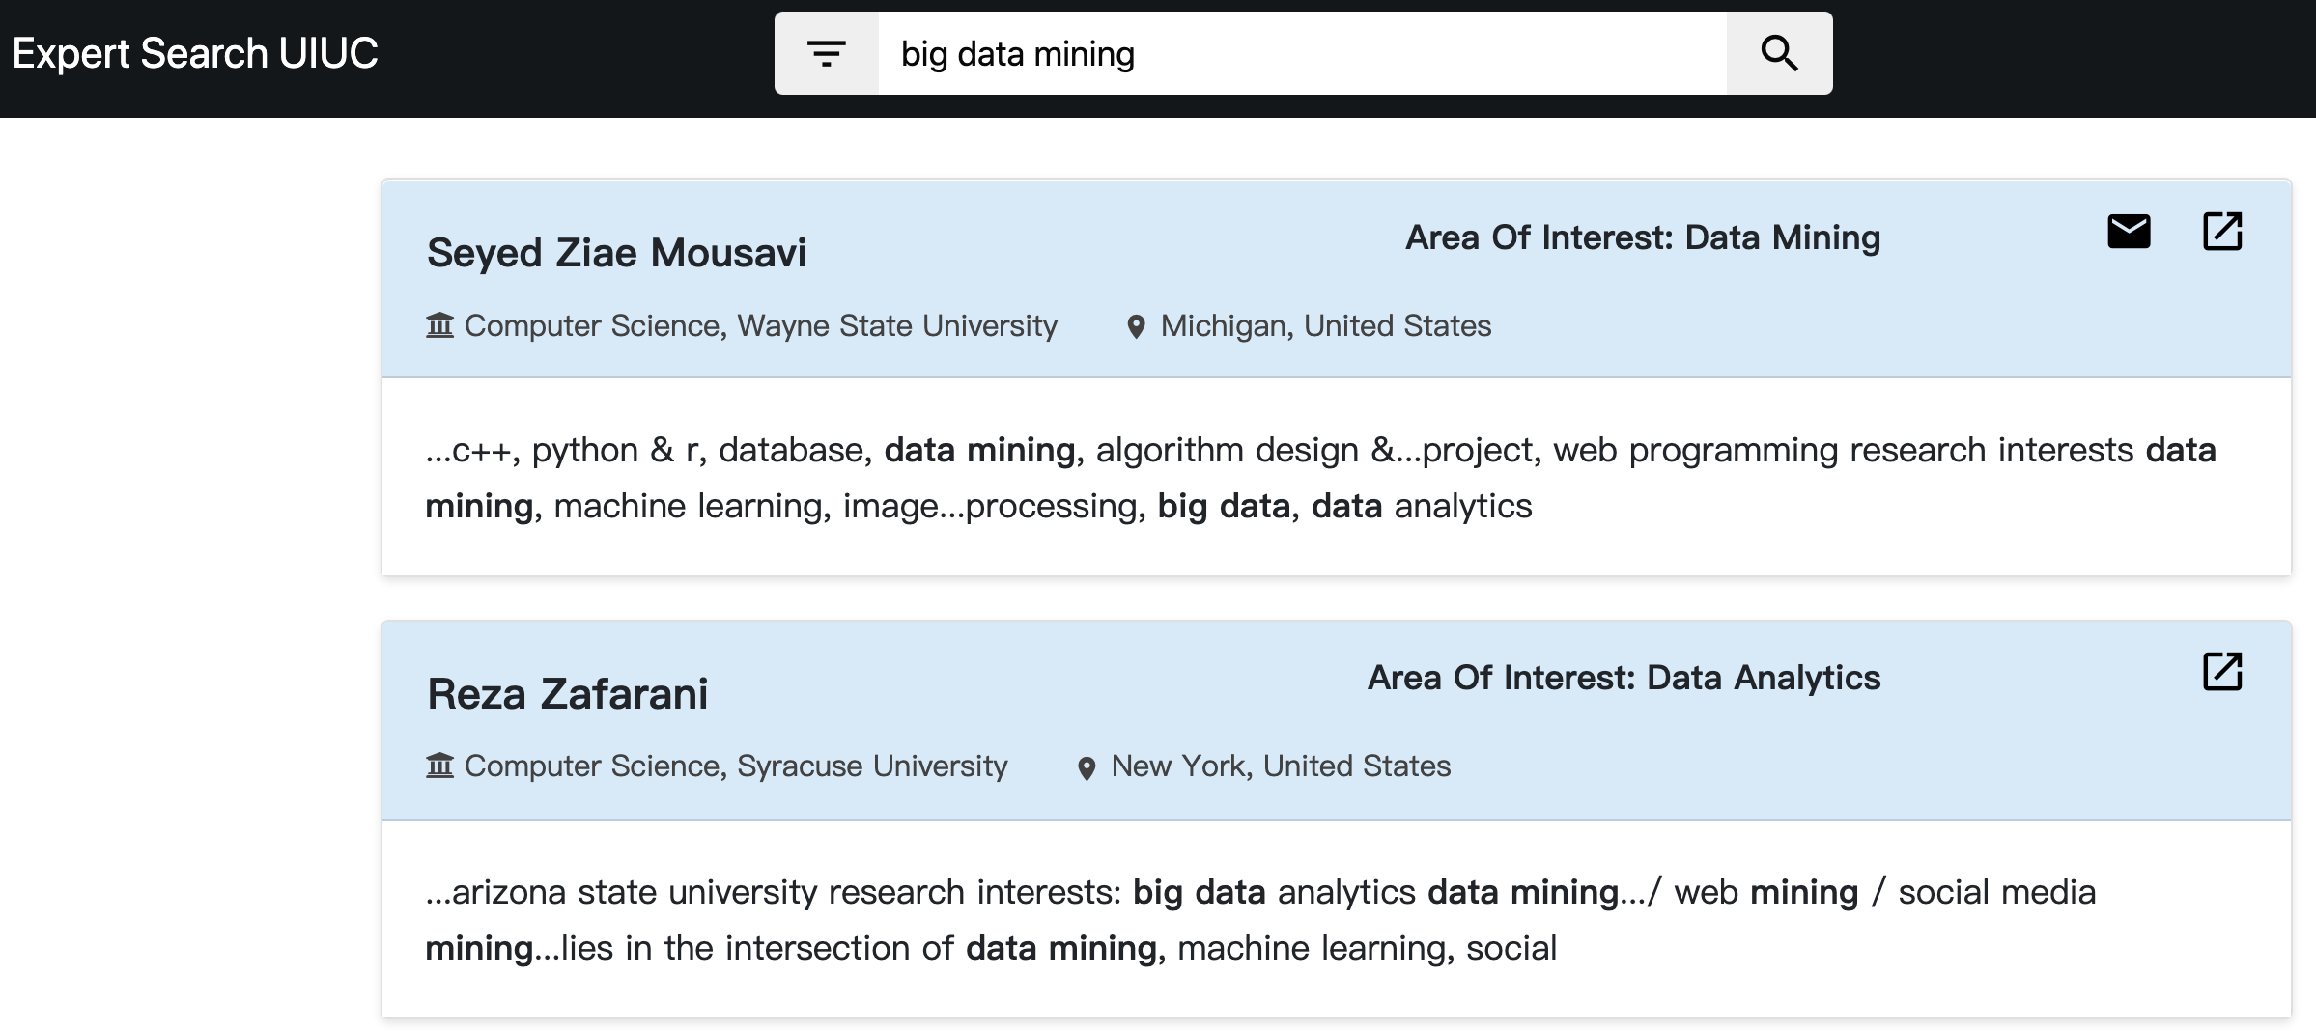
Introduction
The search result of faculties will display in the order of relevance below.

Slide 4
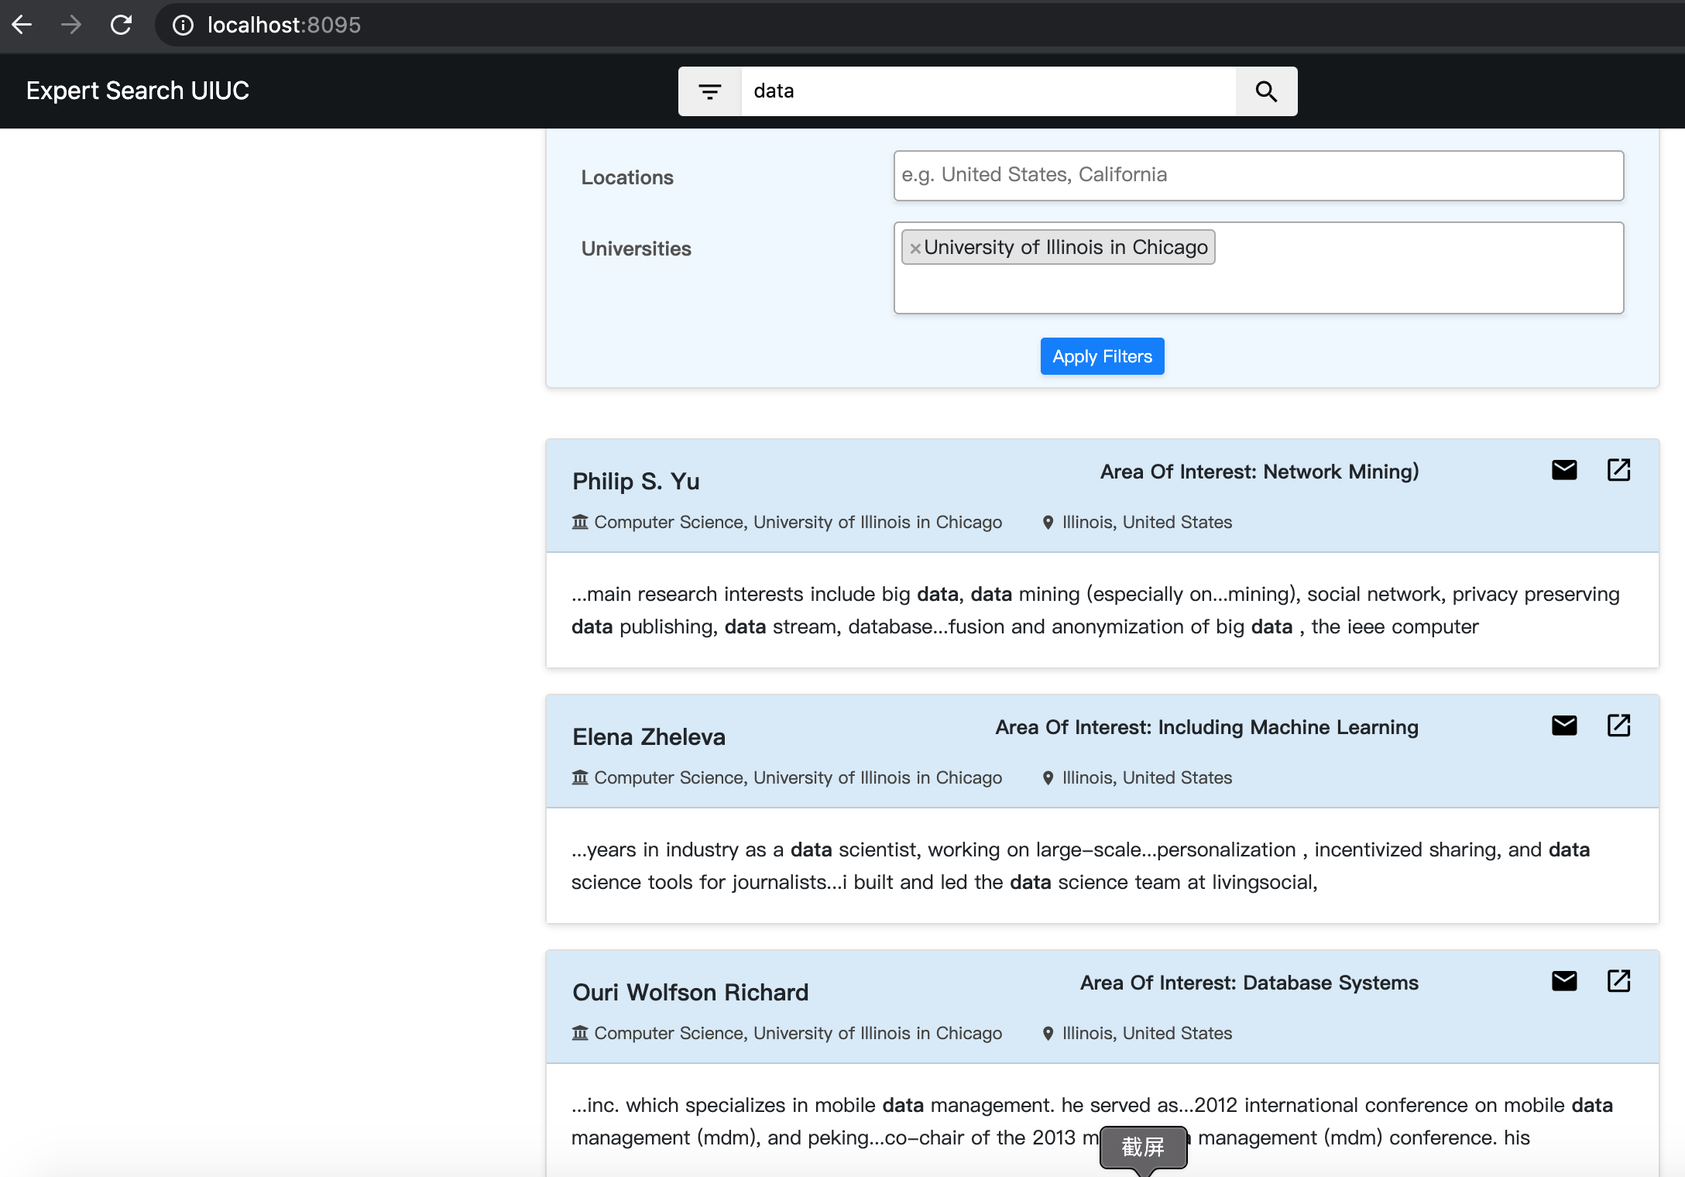
Another Sample Input

Slide 5
Installation
It’s extremely easy to install and run the code on Mac or Linux
On Windows it requires some tricky settings to execute the code. This is because the Python webserver package Gunicorn doesn’t support directly on Windows system, so Docker is required to run the code.

Slide 6
Installation on Windows
Install Git (if you haven’t)
In the folder you want to save the project, right click -> Git Bash Here -> type: git clone https://github.com/losaohan/CourseProject.git
Download and install Docker Desktop for Windows: https://hub.docker.com/editions/community/docker-ce-desktop-windows/
Download and install Pycharm Professional for Windows: https://www.jetbrains.com/pycharm/download/#section=windows
You need to apply an JetBrains account with your Illinois email to have access to the professional version: https://www.jetbrains.com/shop/eform/students.

Slide 7
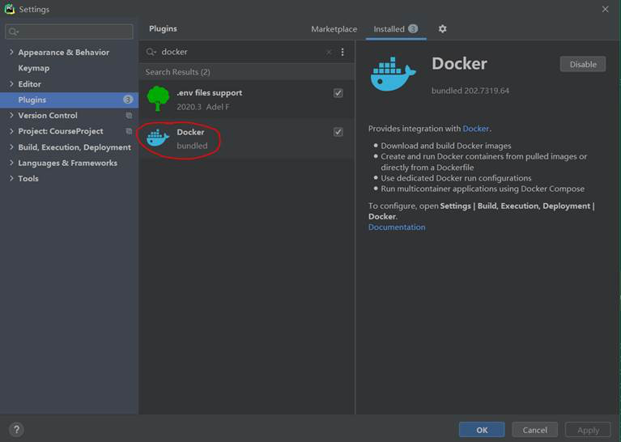
Installation on Windows
Open Pycharm, open the CourseProject folder as project. On the top-left menu, hit File -> Settings -> Plugins -> search for Docker, and install it -> make sure it’s “Enabled”:

Slide 8
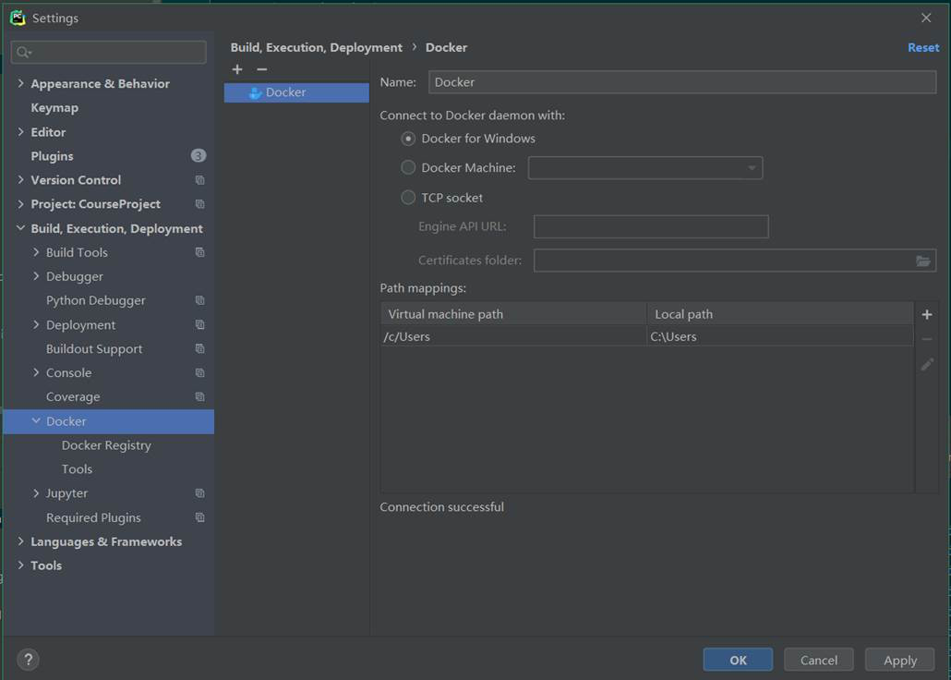
Installation on Windows
In the Settings -> Build, Execution, Deployment -> Docker, create a new Docker service as follows -> hit OK.

Slide 9
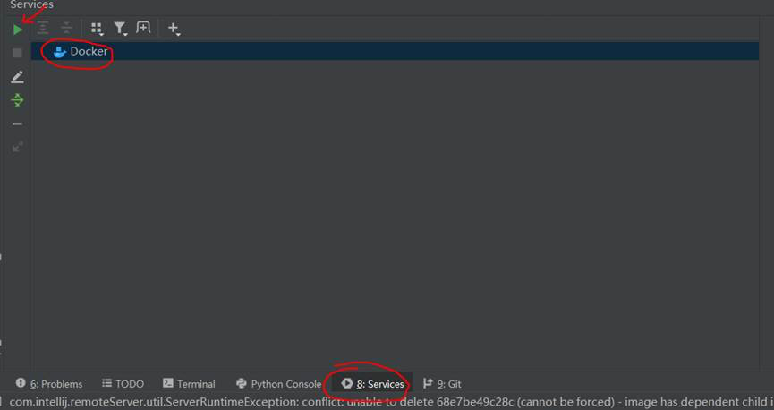
Installation on Windows
A new Docker service will appear on the bottom left menu. Make sure the Docker Desktop you installed in step 1 is running, and hit the green button “connect” on the top left: it will show “Connected” in the middle of the bottom window.

Slide 10
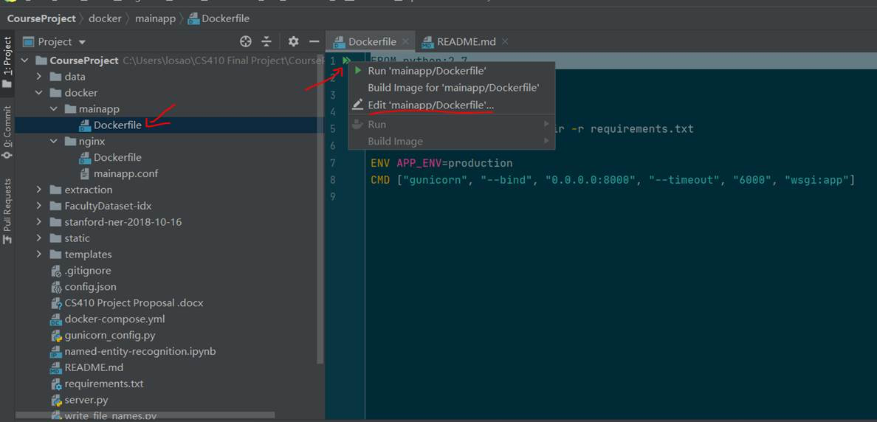
Installation on Windows
In the Project directory, open the file docker/mainapp/Dockerfile. Right click the double green arrow and select “Edit ‘mainapp/Dockerfile’…”.

Slide 11
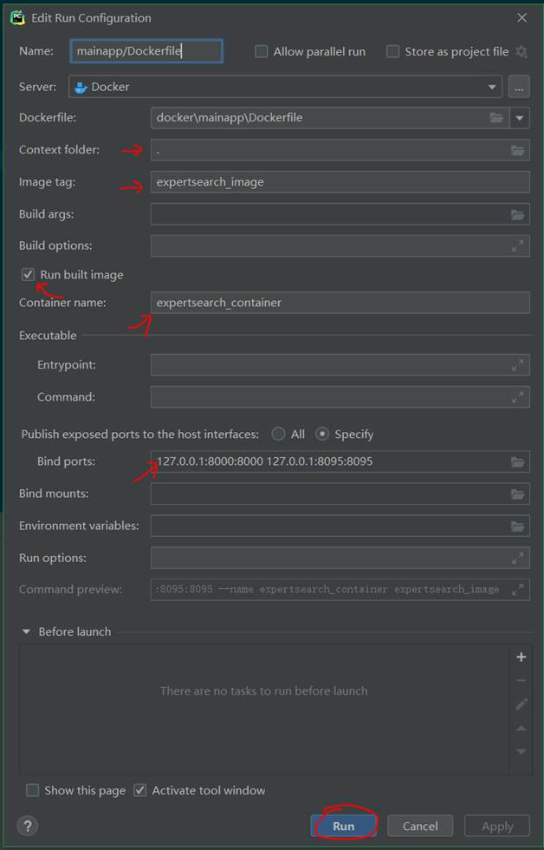
Installation on Windows
Fill in the same setting as below in the pop up config edit window. You could make your own Image Tag and Container Name, but make sure the other settings are the same.

Slide 12
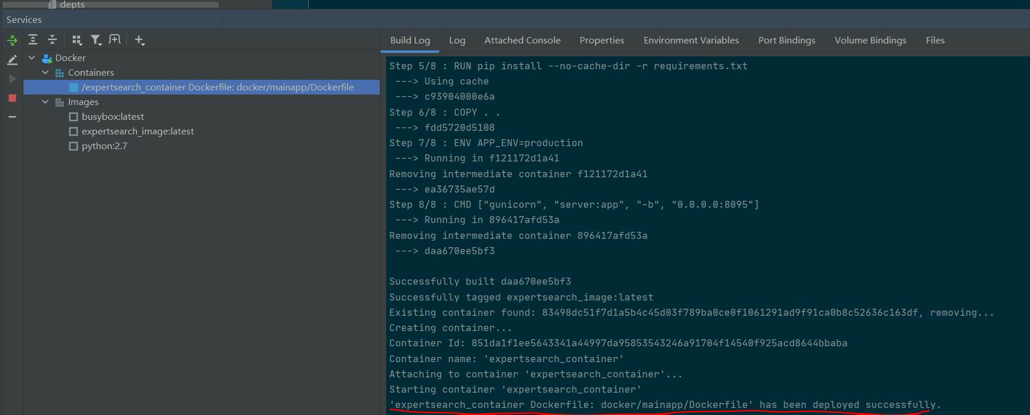
Installation on Windows
Hit Run: the image will start to build, and the container will launch in a few seconds.

Slide 13
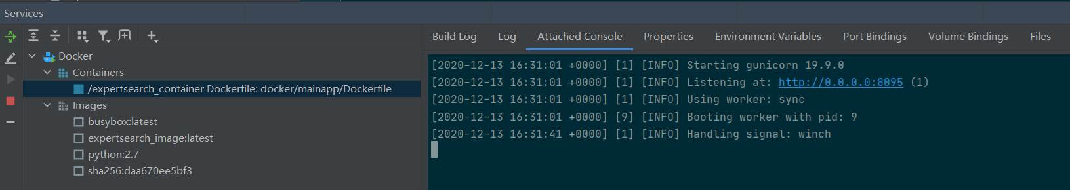
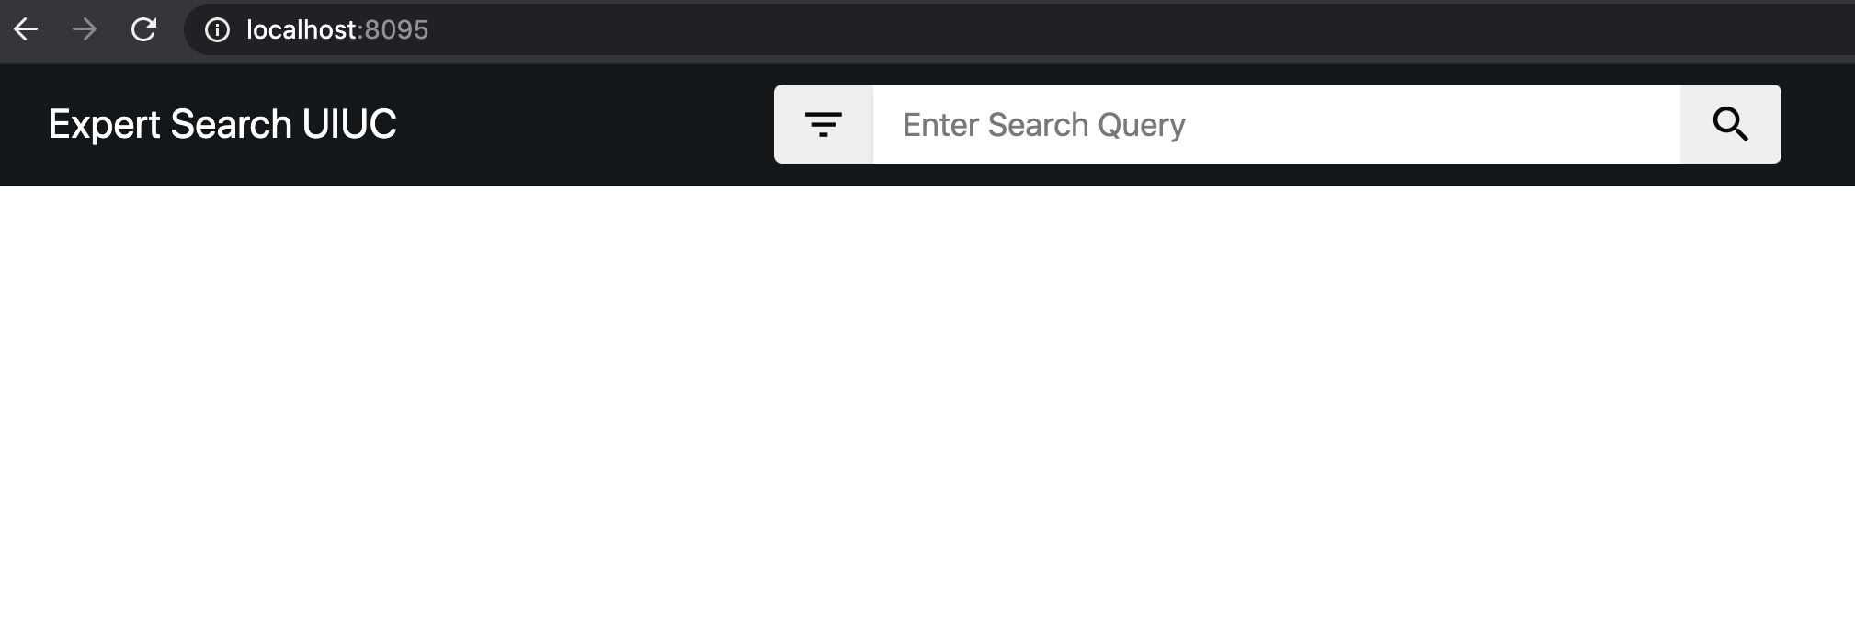
Installation on Windows
In the attached console, you will find the code is running at 0.0.0.0:8095 in the container, which is mapped to 127.0.0.1:8095 in the host machine.
If you type localhost:8095 in your browser, the expert search page will show up

Slide 14
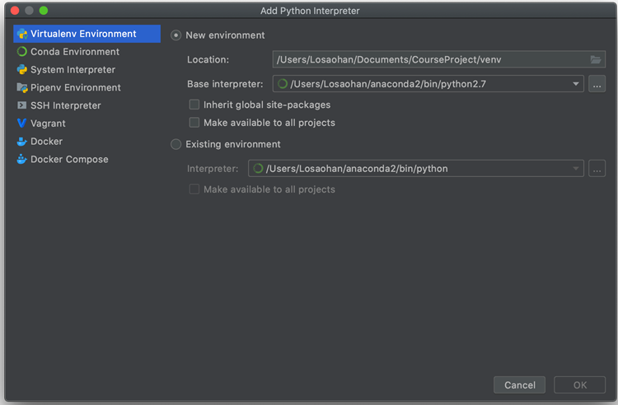
Installation on Mac/Linux
Open Pycharm, open the CourseProject folder as project. Create a new virtual env by choosing your local Python 2.7 as base interpreter.

Slide 15
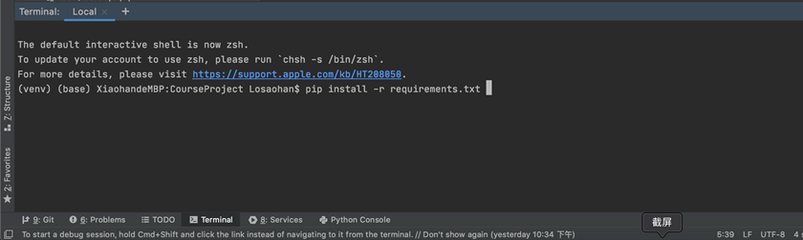
Installation on Mac/Linux
In the activated virtual env, Install the requirements.txt packages by typing: pip install -r requirements.txt

Slide 16
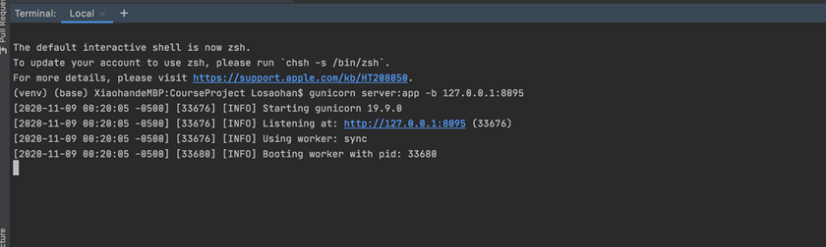
Installation on Mac/Linux
Type gunicorn server:app -b 127.0.0.1:8095 in the terminal and the server will launch.
Type localhost:8095 in your browser, the expert search page will show up:

Slide 17
Thanks!

